Slide 1


Governing Education: the rise of data
JENNY OZGA
DEPARTMENT OF EDUCATION, UNIVERSITY OF OXFORD
(jennifer.ozga@education.ox.ac.uk)
Université de Strasbourg Institut d’Études Avancées
^{21st September 2015}

Slide 2


Before data….

Slide 3

And now…….

Slide 4

The data-based world and its consequences……
‘This is a world where massive amounts of data and applied mathematics replace every other tool that might be brought to bear. Out with every theory of human behavior, from linguistics to sociology and psychology. Who knows why people do what they do? The point is that they do it, and we can track and measure it with unprecedented fidelity.
With enough data, the numbers speak for themselves’
(Anderson 2008 quoted in boyd and Crawford 2012)

Slide 5
The Overarching ‘Project’
Over the years we’ve tried to:
Investigate and promote recognition of education/schooling/learning as a key policy field in Europe, and a site of activity of the EC- through interactions with political science…using some concepts from PS/political sociology;
Identify processes through which the Education policy space is ‘made’-especially the construction of indicators and benchmarks, practices of standardization, and the growth of data…again, drawing on trans-disciplinary resources-social geography, science and technology studies;
More recently-we’ve focused on exploring and analysing the work of policy actors, interacting with data-especially those do ‘political work’; ie work that: ‘both discursively and interactively seeks to change or reproduce institutions by mobilising values’ (Smith 2009, 13)-Inspectors of Education are a paradigmatic case.

Slide 6
Constructing Europe: processes of governing
Europeanisation (and globalisation) produce new relations between the supra/transnational, national and local- ‘assemblages’ of apparatuses, personnel and practices (Clarke 2012) -varied in scope, dynamic, involving many agents within and across borders and levels, and shaped and reshaped in action.
Governing is now the shared concern of different agents and interests, and not just a single entity.
This requires us to think about how governing works on and across categories–nations, levels, sectors, agencies, cultures ….. reworking them in the processes of governing-
……..and about how data act to hold these disparate elements together.

Slide 7
Data and change in governing
-that government/governance is changing in parallel with the availability and use of international performance data;
-that governing assemblages may be understood as ‘held together’ by the meaning-making activities of political actors who work in them;
-that meaning-making is increasingly constructed through data-based and comparative knowledge, promoting ‘cognitive consensus’ Grundmann and Stehr (2013) about policy directions;
-that this cognitive consensus rests on a dominant narrative of technical capacity and capability through which comparative data analysis forms the basis of ‘levers for action’ across and within national settings;

Slide 8
Data and change (ii)
-along with an imaginary of society organised in networks both constructed and held together through the flow of comparative knowledge and data (and free of social science explanation)
-and that all these developments have [problematic] consequences for the politics of education, as cognitive consensus ‘removes the social from acts of knowing’ (Savage 2013).
By ‘politics’ here, I mean the spaces that allow contestation of the ‘cognitive consensus’ or alternative ‘meaning-making’, with attention to the place of professional expertise and reshaping of citizens as ‘informed consumers’ characteristic of recent decades (perhaps especially in England).

Slide 9
Changing Governance (adapted from the project ‘The Changing Role of Knowledge and Policy in health and education’: www.knowandpol.eu)
Bureaucracy
Post-Bureaucracy
National State-centred
Hierarchical organisation/formal regulation
Main actors: formal policy makers, professionals
Actors and organisations defined by state and sector
Action through norms: changing rules
Poly-centric-inter/trans-national
Diversity of actors, public/private hybrids, non-formal actors (consumers, 3rd sector)
Networked, fluid, blurred hierarchy
Knowledge (data) based action

Slide 10
Changing Knowledge
Knowledge
Knowledges
Dominant legitimacy: Scientific/Professional knowledge
Limited knowledge holders
Disciplinary knowledge-segmented, specialised
Slow circulation within closed systems
Legitimacy varied-know how, experiential and scientific
Diversity of recognised knowledge holders
‘what (ever) works’-usable, auditable, translatable –containing ‘levers for action’
Fast-moving, internationalised, data-based

Slide 11

Comparative simplification
A key feature of governing knowledge is that it is comparative.
Comparison frames knowledge-governing relations through establishing three key principles
that regular and systematic assessments are truthful practices for the improvement of national education systems;
that such improvement has to be analysed in relation to the pace of change of other countries;
that international comparison of student performances develops the quality of national education systems while capturing educational complexity and diversity (Carvalho, 2012).
The principle of comparison is also important within the national: in comparisons of schools and head/teachers/learners.

Slide 12
Governing needs de-contextualised, actionable knowledge
In current conditions, knowledge claims are most powerful if they are trans-historical and trans-situational:
‘the decline or loss of the context-specificity of a knowledge claim is widely seen as adding to the validity, if not the truthfulness, of the claim’ (Grundmann R and Stehr, N (2012) The Power of Scientific Knowledge Cambridge, Cambridge University Press: p.3)
Knowledge becomes relevant to governing when:
‘it includes the policy options that need to be manipulated” [and such] ‘practical knowledge (…) provides knowledge that identifies the levers for action’ (Grundmann and Stehr 2012:179).

Slide 13
Experts, consultants and the problem of endless possibility
Governing work demands skills in translating information into ‘practical knowledge’, mediating conflict and brokering interests. Networks of experts [often with commercial interests] promote cognitive consensus that makes political action easier. Moreover:
‘their attributes as experts and consultants tend to obscure the ideological and political dimension of their activities of knowledge production for policy’ (Shiroma, 2014, p. 2).
‘The rapid growth of experts, advisers and consultants in education arises from the rapid expansion of knowledge/information, this provides opportunities for simplification of the problem of endless competing interpretation in order to provide a basis for action’ (Grundmann & Stehr, 2012, pp. 20-21).

Slide 14
Euro-data
‘‘…..because when you sit up to your neck in the Scottish system, everything is Scottish. Everything is Scottish. [You feel] This is our system, we defend it as a fortress and all these influences from outside, they should be kept away.
By sitting here and making comparative analysis, we identify what is specifically Scottish to the Scottish system. What is it that you should actually defend to keep these roots in national culture and national institutions ….. We know it, we have the information, we have this distance that is necessary to do it. And we can compare and find out what is it that shines in the Scottish system.’
[Senior EU Analyst Brussels]

Slide 15

PISA Data
There’s a lot of talking, an awful lot of talking around the table……..I seldom remember any debates on that level. It was more about Andreas Schleicher driving the whole agenda along as a process- very controlled, time controlled and then just people contributing to particular issues of decision making.’ [CP86]
‘The guys in ACER, they have a strong role. They would turn up in these meetings but they would come and talk technical language […] national representatives […], with some exceptions, they would just be sitting, just taking on trust that this was the way to go. There was very limited- in my experience- challenge of anything on the technical side’ (CP86)

Slide 16
The ‘popular currency’ of data
‘ The ‘popular’ work that data do is to make connections to individual citizens/learners/pupils in such a way as to steer or mediate their decisions and actions in relation to economic demands, to family relationships and all other aspects of everyday life (cf. Rose and Miller 1992, 180)’.
This development is not confined to ‘official’ data:
‘…social media has grown into an efficient tool for the government of individuals and masses. The Internet sites that promote the neoliberal evaluation culture are motivated by and deeply embedded in contemporary social and political reforms, and rely on a new mode of regulation – governing at a distance- through the regulated choices of individual citizens, and through specifying subjects of responsibility, autonomy and choice’. (Piattoeva 2014:8)

Slide 17
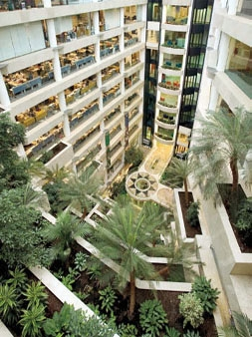
Governing by Data in England
‘…..its interesting to reflect on how the work of a central government policy department has evolved….In fact actually we’ve been developing a concept here in the Department which we’ve called ‘the bridge’ where we corral all of this data and information and at a glance now across all local authorities in England you can go downstairs and look at a big screen and you can look across all the key performance areas and that’s actually across all the social care areas as well as education….
So we’re doing quite active performance management of the system and that’s quite a powerful tool’ (Senior DfE official)

Slide 18
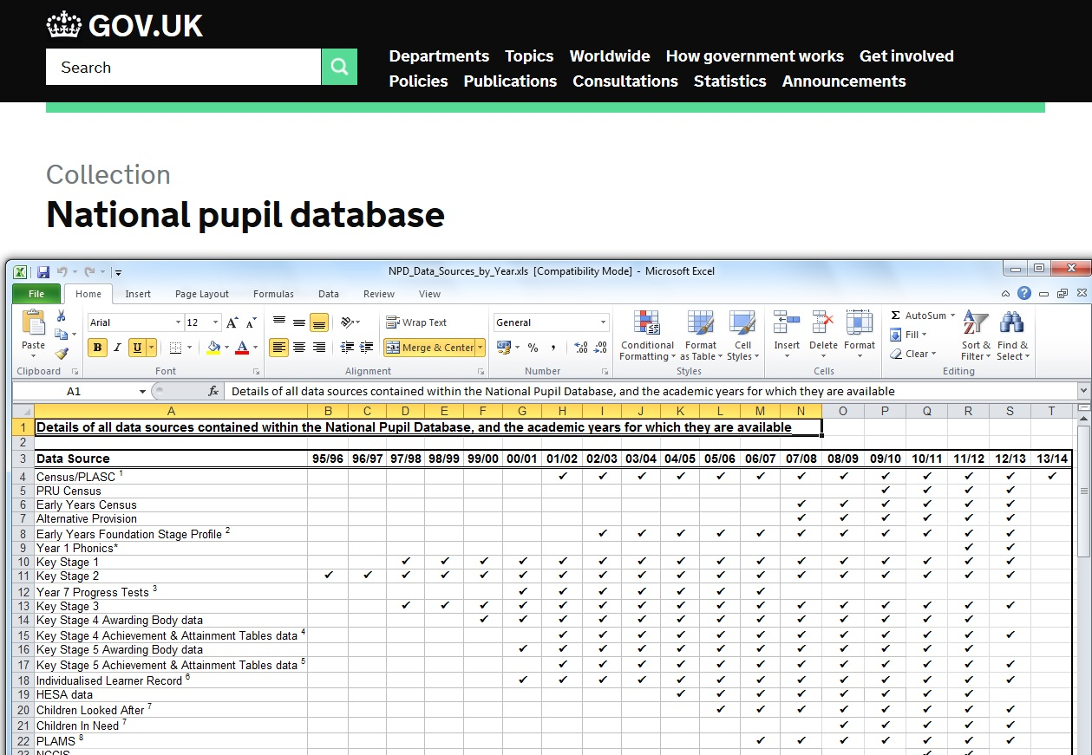
Pupils into performance data

Slide 19
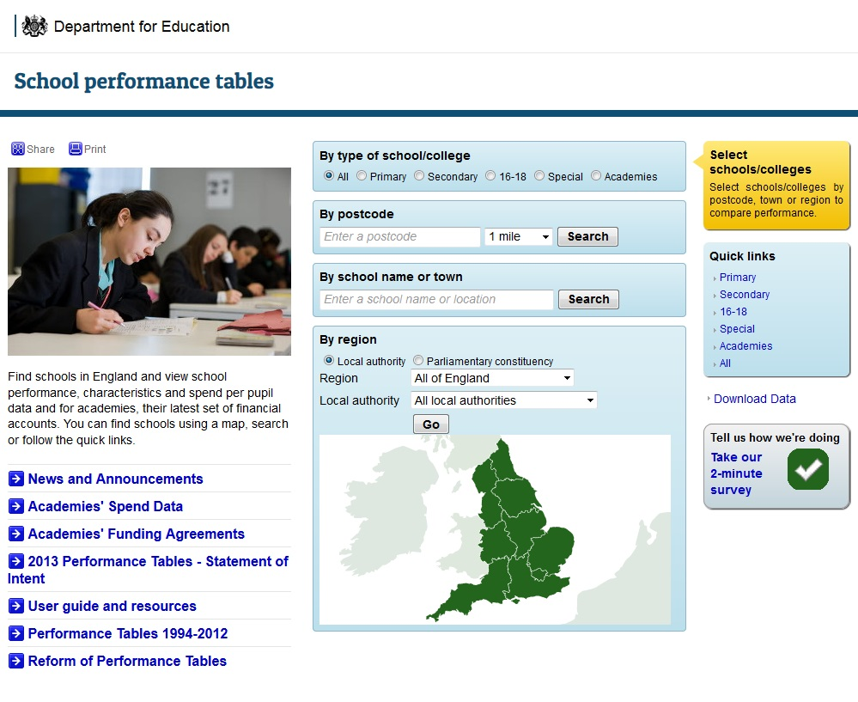

Slide 20


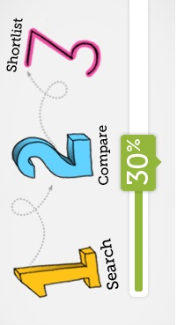

Slide 21
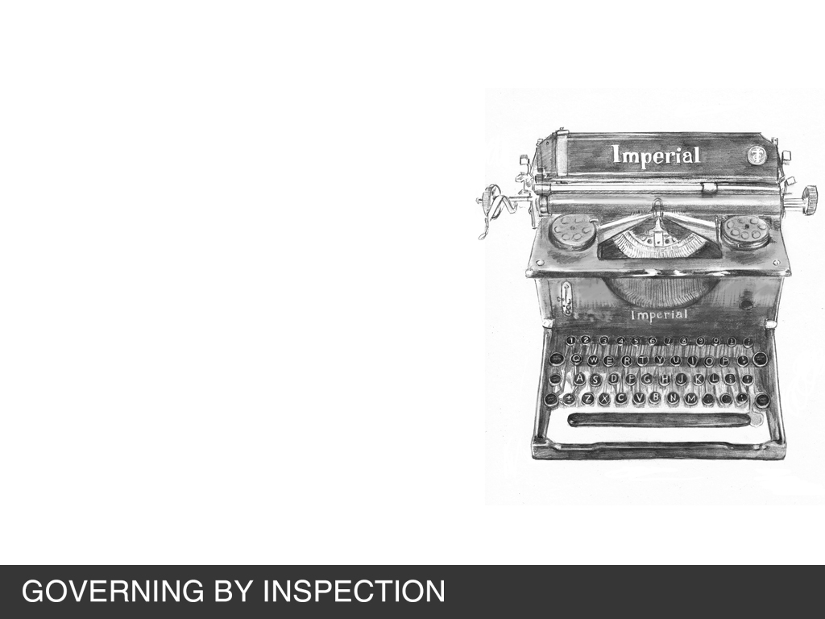
Inspection’s distinctive features
it is directly observational of sites and practices. That is, in the case of schooling, inspectors are empowered (and required) to enter the world of the school and observe what takes place within it;
it is a form of qualitative evaluation, involving the exercise of judgement rather than only the calculation of statistical regularity/deviation. Judgement is at the core of the activity;
it is embodied evaluation: the inspector is a distinctive type of agent who embodies inspectorial knowledge, judgement and authority.
There is, therefore, a possibility of tension in arriving at a judgement between embodied evaluation and disembodied, de-contextualised performance data.

Slide 22
Data and Judgement
Inspectors in England (especially Her Majesty’s Inspectors-HMI) believed (before 1992, when Ofsted-the Office for Standards in Education-was formed) that embodied and encoded expert knowledge (a kind of inspector-connoisseurship or artistry) forms the most appropriate basis for judging schooling.
The validity of their judgment is tied to the background, training and, most importantly, the experience of the inspector, and builds on standards that are internalised versions of collective judgments’ (Lindgren and Clarke 2014)
[The majority of post-1992 Ofsted inspectors were provided by commercial companies like SERCO]

Slide 23
Before the Inspection…
The lead inspector analyses evidence including:
-the summary of the school’s self-evaluation (if available)
-data from RAISEonline report, the sixth form performance and assessment (PANDA) report, the learner achievement tracker (LAT) and available data about success rates from the school data dashboard the Level 3 Value Added (L3VA) data.
the previous inspection report
the findings of any recent Ofsted survey and/or monitoring letters
responses from parents/carers on Parent View (Ofsted’s online survey available for parents)
issues raised about, or the findings from, the investigation of any qualifying complaints about the school
information available on the school’s website, which may include a prospectus and other information for parents.

Slide 24
Pre-Inspection Data Analysis includes
- pupils’ attainment in relation to national standards (where available) and compared with all schools, based on data over the last three years where applicable, noting any evidence of performance significantly above or below national averages; trends of improvement or decline; and inspection evidence of current pupils’ attainment across year groups using a range of indicators, including where relevant:
− the proportion of pupils attaining particular standards
− capped average points scores
− average points scores
− pupils’ attainment in reading and writing
− pupils’ attainment in mathematics

Slide 25
Data and the Inspection Event
In order to make a judgement about the quality of education provided in the school, inspectors must first make four key judgements.
These are:
the achievement of pupils at the school
the quality of teaching in the school
the behaviour and safety of pupils at the school.
the quality of leadership in, and management of, the school.
Inspectors will decide whether the school is ‘outstanding’ (grade 1), ‘good’ (grade 2), ‘requires improvement’ (grade 3-changed from ‘satisfactory’ in 2011) or ‘inadequate’ (grade 4).

Slide 26
Practices of Standardisation
An inspector finishes an inspection ….has to write a report the following day. No arguments, that’s the timeline set by Ofsted, the commercial timeline that we have to meet. That report is then subject to QA [Quality Assurance] reading. …So we read the first draft of the report against ..guidance provided by Ofsted. …. there’s a number of musts: must be included on this, must say this, must say that, so the QA reader has a job to cross-check that. Then there is a compliance zone, things that must, must be in the report, any of those are missing…that’s a bit of a no-no really. Then we have things around the quality of the writing. And we have to meet those five criteria to make sure that the report is published. And essentially within that process the QA is a day. (Contract inspector 012)

Slide 27
Practices of standardisation (2)
‘……..then it goes to Ofsted and an HMI signs it off…….….now if HMI say no we are not signing it off, then it becomes a key performance indicator failure for the provider…..….at the last inspection I said, ok teaching and learning are definitely satisfactory, and he [the HMI signing off the report] said ok we agree, then we came to leadership and management and we said , if teaching and learning is satisfactory then leadership and management must be too, but he said , I would have expected leadership and management to be good because if leadership and management are less than good then we couldn’t even keep the thing at satisfactory.
…..in the end what inspectors are doing is saying ok well I have to follow this rule….there isn’t a rule but I have to follow it….’ (Contract Inspector 012).

Slide 28
Coded Knowledge
Code is a system of regulation, both structured and structuring, and inspectors are disciplined and discipline others through their coding practices.
Software codifies the world into ‘rules, routines, algorithms, captabases that are then used to do work in the world’ (Kitchin and Dodge 2011)
Data processes that, on first encountering them, seem to promote transparency, provide information and assist in sorting things out, reveal themselves on closer scrutiny to be highly powerful social practices (e.g. processes of observing, measuring, describing, categorising, classifying, sorting, ordering and ranking) (Halford et al. 2013, p.180).

Slide 29

…transactions have long been the basis of government administrative systems and the mainstays of government record keeping, monitoring and evaluation, and, in social policy, conduct and behaviour have been key indicators and registers of identity.
What is new is the digitization of these records, the possibility of real-time tracking of transactions and the potential to join up transactional data distributed across government sites and functions. In other words, digitized data are transforming government knowledge practices. (Ruppert 2012:116)

Slide 30

Data make people up
Predictive profiling, calculates the future behaviours of an individual and acts on them pre-emptively, using ‘actionable intelligence’ to make decisions and set priorities. Data thus define who an individual is, classifying what they are and evaluating what they may become.
The modelling of education through digital data fosters a sense of algorithmically driven ‘systems thinking’ through which complex (and unsolvable) social problems associated with education can be seen as complex (but solvable) statistical problems..
This may construct ‘statistical discrimination’ as individuals are re/classified in particular groups, and included/excluded on the basis of the attributes of these groups and data ‘segments’ to which they are assigned. (Selwyn 2014:11)

Slide 31
Trust in Numbers?
‘Numbers don’t count by themselves, it is the procedures that stand behind them that elicit authority-the trust-making enterprise is also sustained, importantly, by the social position of the number-gatherers and the social networks in which they are embedded’
‘Auditing transforms the social role of knowledge in interaction with politics-it curtails political imagination and distorts the moral conscience’
(Fourcade 2010: 571: 573)

Slide 32
Carvalho L.M. (2012) The fabrications and travels of a knowledge-policy instrument. European Education Research Journal 11(2): 172–189.
Fazekas, M. and T. Burns (2012), “Exploring the Complex Interaction Between Governance and Knowledge in Education”, OECD Education Working Papers, No. 67, OECD Publishing. http://dx.doi.org/10.1787/5k9flcx2l340-en
Fenwick, T. Mangez, E. and Ozga, J. (eds) (2014) Governing Knowledge: Comparison, Knowledge-based Technologies and Expertise in the Regulation of Education (World Yearbook of Education 2014) London, Routledge pp101-113
Fourcade, M. (2010) ‘The Problem of Embodiment in the Sociology of Knowledge: Afterword to the Special Issue on Knowledge in Practice’, Qualitative Sociology 33, pp. 569–574.
Grundmann R and Stehr, N (2012) The Power of Scientific Knowledge Cambridge, Cambridge University Press
Halford, S., Pope, C. and Weal, M. (2013). Digital futures? Sociological challenges and opportunities in the emergent Semantic Web. Sociology, 47 (1):173-189
Hayek, F (1969) ‘The Use of Knowledge in Society’ in Hayek, F. Individualism and Economic Order University of Chicago Press 77-91
Kitchin R & Dodge M (2011) Code/Space: Software and Everyday Life Cambridge, Mass. MIT Press.
Lawn, M. (2013) A Systemless System: designing the disarticulation of English state education European Educational Research Journal 12 (3)
Piattoeva, N. (2014): Elastic numbers: national examinations data as a technology of government, Journal of Education Policy, 30, 3, 316-334
Shiroma EO (2014) Expert consultants and Knowledge Production in Fenwick, T Mangez, E and Ozga, J (eds) Governing Knowledge: Comparison, Knowledge-based Technologies and Expertise in the Regulation of Education (World Yearbook of Education 2014) London Routledge pp101-113
Selwyn, N (2014) Data entry: towards the critical study of digital data and education Learning, Media and Technology, DOI: 10.1080/17439884.2014.921628

